Slide 1
SOFT POWER ENGINEERING®
How Afghan and Pakistani Mullah’s and Businesses Together with U.S. Businesses Lead Coordinated Effort to Calm Tensions following Holy Qur’an burning

Slide 2
Who is Soft Power Solutions?
Soft Power Solutions
A Native Hawaiian Organization owned SBA 8a
Mission
Enhance government, community, and industry capacities to advance our nation’s interest in the geopolitical realm of Soft Power such Security Cooperation events or Disaster Response Risk Reduction (DRRR)
People
A leadership team of scientists, engineers, and business leaders distinguished by their successful military and civilian accomplishments.

Slide 3
Situation
Improper disposal of Qur’ans at Bagram AB
Perceived as deliberate disrespect
Was actually an act of uninformed personnel
Soft Power Solutions (SPS) CEO initiated discussion with Brig (R) Effendi
SPS & Brig (R) Effendi decided to help with messaging
Capable of diffusing issue
Form an international team of businesses
Develop plan of action

Slide 4
Plan of Action
Goal
Support US efforts of transparency and rebuild relationships with a gesture of respect and compassion by the American people

Slide 5
Plan of Action
Phase 1: Through March 9
Distribute Holy Qur’ans to as an initial gesture
Attach notes from US businesses expressing compassion and respect
Identify 12 Afghan and 4 Pakistan provinces for distribution
Distribution ceremonies presided over by respected Afghan leaders
Estimated cost: $25K
To date: 5,000 Holy Qur’ans distributed

Slide 6
Plan of Action
Phase 2 Through June 2012
Long term messaging to prevent escalation
Recognition of contributors
Assess effectiveness of Phase 1
Develop courses of action
Religious gatherings
Engagements that affect PRIME
Develop public-private partnership initiatives
Strategic messaging (Pashtunwali)

Slide 7
Outcome
Fatwas of forgiveness declared by religious leaders
12 Afghan Provinces
4 Pakistani provinces
Over 22 distribution ceremonies with support from community, religious, and government leaders
Afghan army flag officers
Provincial governors & community leaders
Government officials (including judges and ministry officials)

Slide 8
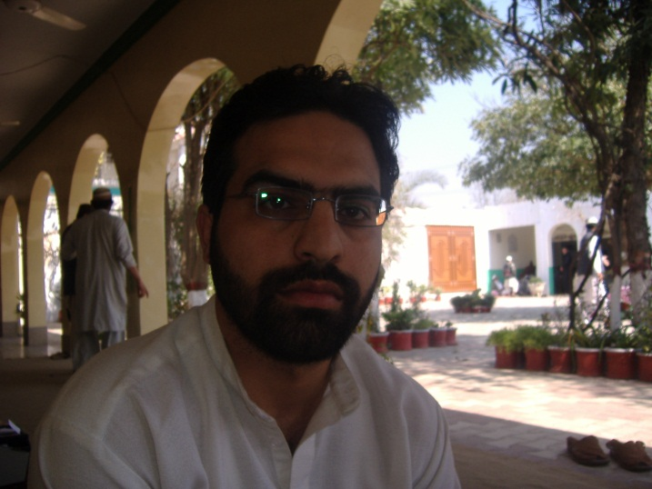
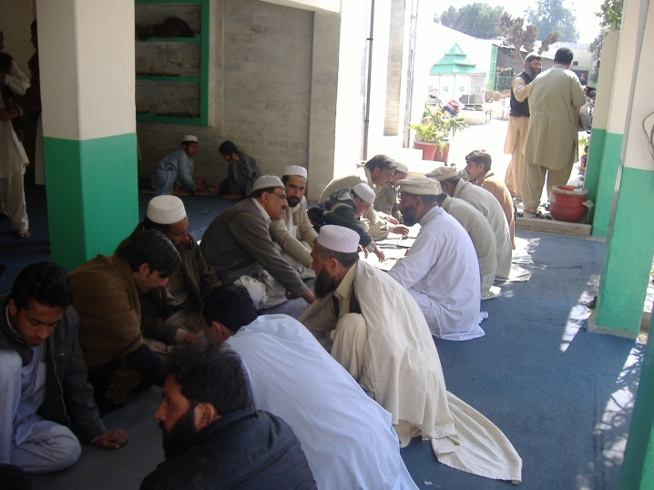
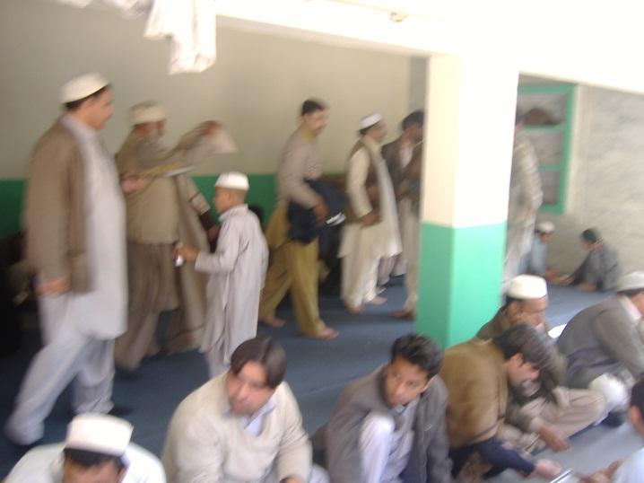
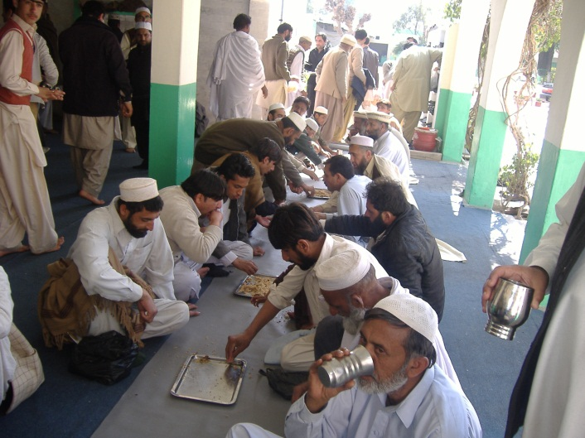
Qur’an Distribution Activity
British Muslims from London UK at the Center.
Food being served to the guests.
Another view of food being served to the guests.
Another shift of guests having lunch.

Slide 9
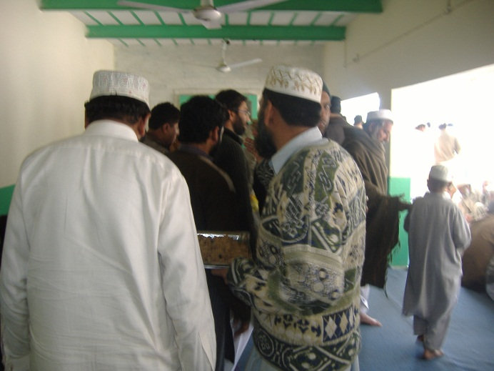
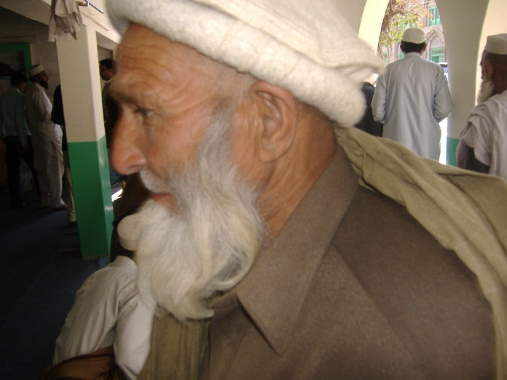
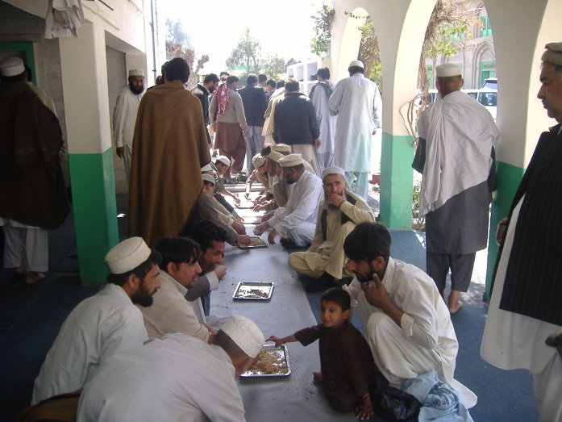
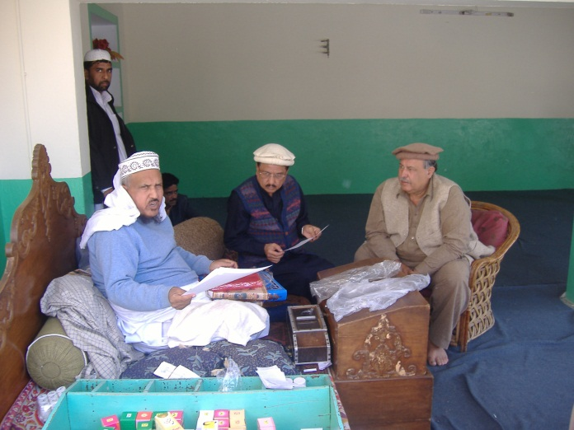
Qur’an Distribution Activity
Departing for Friday prayers.
A tribal chief.
Another view of food being served to the guests.
Al Haj Rizwan Badshah, Mr. Asif Khan and Sardar Azam Effendi explaining your letters and showing samples of Holy Quran.

Slide 10
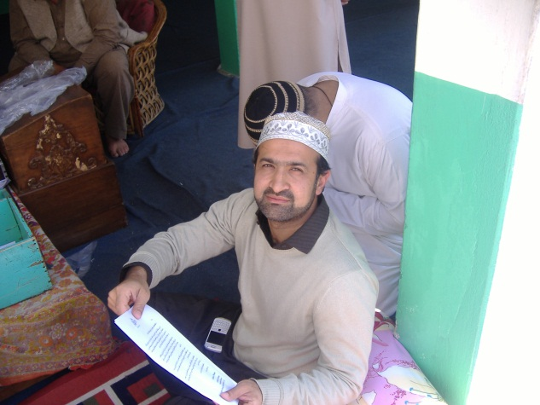
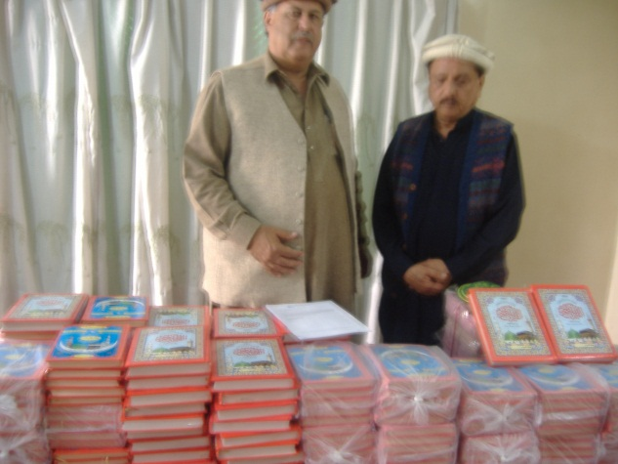
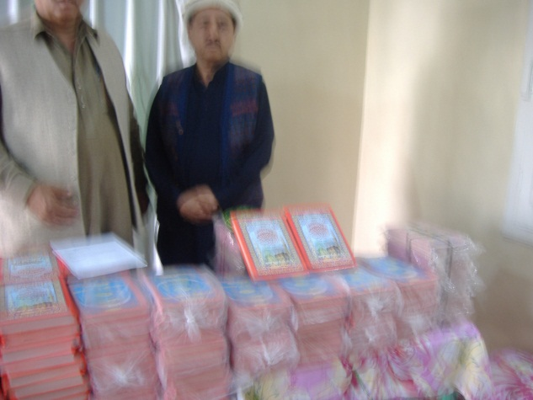
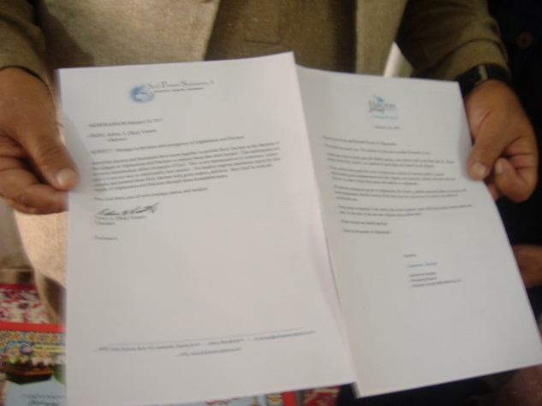
Qur’an Distribution Activity
Mr. Bilal analyzing your letters an Oxford graduate and a successful businessman.
Sardar Azam and Mr. Asif Khan explaining the purpose of the distribution ceremony.
A view of the Holy Books.
Sardar Azam showing the letters from Soft Power Solutions & Halcyon Group International.

Slide 11
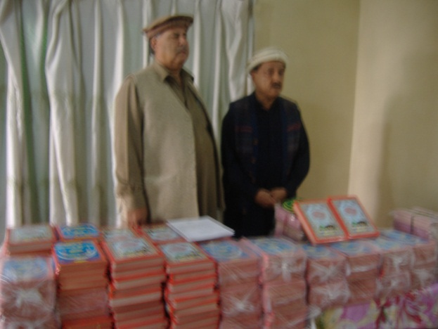
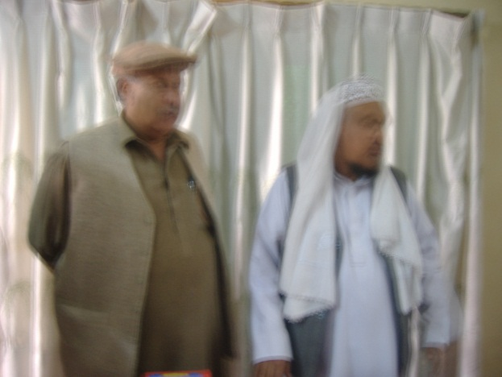
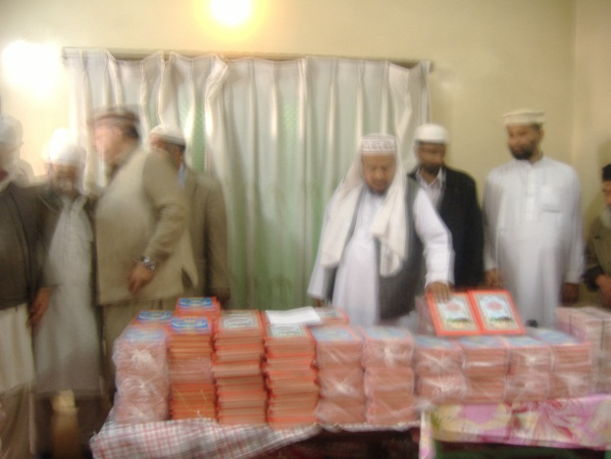
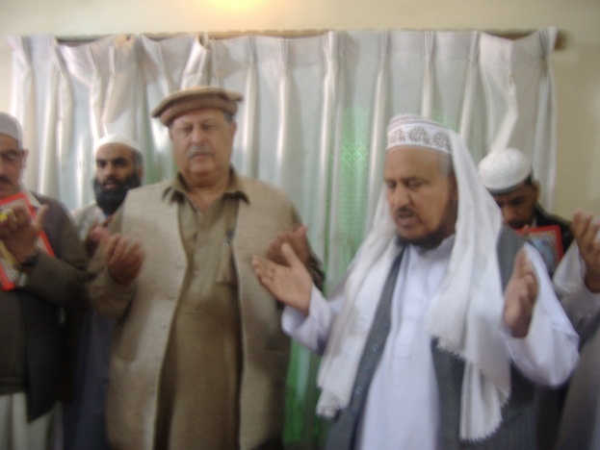
Qur’an Distribution Activity
Answering questions from the participants.
Sardar Azam with Al Haj Rizwan Badshah.
Al Haj distributing Holy Qurans amongst the participants.
Al Haj Rizwan and Sardar Azam praying collectively for humanity, peace, sanity and thanking the people of US for their compassion and sympathisizing with Muslims around the world especially Pakistan-Afghanistan.

Slide 12
Soft Power Engineering®
Definition
“The repeatable scientific method for delivering predictable, quantifiable factors and elements to support community stability and security” – Dr. Dan Tolley, Soft Power Solutions LLC
Case Study
Soft Power Engineering effort between Pakistan and US to derive needs and solutions through interaction and co-creation with government officials, local leaders and businessmen/farmers

