Slide 1
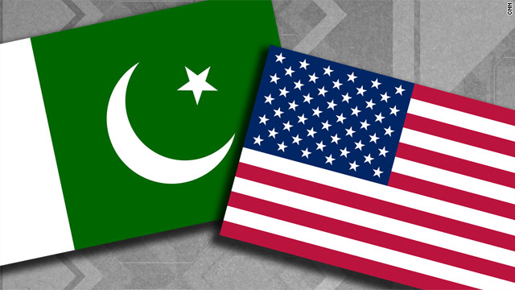
SOFT POWER ENGINEERING®
A Case Study
Pakistan

Slide 2
Agenda
Who is Soft Power Solutions?
Soft Power Engineering® Overview
Soft Power Engineering® Proof of Concept in Pakistan
Pol-Mil Topics and Issues
Findings
Way Ahead

Slide 3
Who is Soft Power Solutions?
Soft Power Solutions
A Native Hawaiian Organization owned SBA 8a
Mission
Develop Public/Private partnerships for government, community, and industry to build capacities to advance our nation’s interest in the geopolitical realm of Soft Power.
Such interests include Security Cooperation events or Disaster Response Risk Reduction (DRRR)
People
A leadership team of scientists, engineers, and business leaders distinguished by their successful military and civilian accomplishments.

Slide 4
Soft Power Engineering®
Definition
  “The repeatable scientific method for delivering predictable, quantifiable factors and elements to support community stability and security” – Dr. Dan Tolley, Soft Power Solutions LLC
Case Study
  Soft Power Engineering effort between Pakistan and US to derive needs and solutions through interaction and co-creation with government officials, local leaders and businessmen/farmers

Slide 5
Soft Power Engineering®
- Scientific Methodology - ABCDE
Community Stability and Security
Build Capacity
Assess
Desired
End-State
Through Co-Creation

Slide 6
Soft Power Engineering®
- Defining Soft Power Measures
CREW™ – defining a community’s natural capacity
  Climate
  Resources
  Energy/Environment
  Water
PRIME™ – defining a community’s modifiable capacity
  Perception and education
  Religion and Ideology
  Improved energy and environment
  Medical and health
  Economics

Slide 7
Soft Power Engineering®
- The Case Study
The Goal was to determine how Soft Power Engineering could be used to assess and define cooperative steps that can effectively engage Pakistan communities affected by recent floods.
Additionally, our visit is to explore factors that affect the U.S. – Pakistan relationships and provide focused insights to interested U.S. government organizations

Slide 8
Soft Power Engineering®
- Engagement Strategy
Identify locally knowledgeable businessmen, with connections to both local people and high level politicians
Use our scientific methodology, local businessmen, and leaders at all levels for engagements
  Meet with locals to determine their situation and goals
  Meet with politicians to determine their situation and goals
  Meet with businessmen and educators who can help drive the derived needs to reality
Derive needs, requirements, and priorities
Repeat meetings until we reach level of achievable consensus

Slide 9
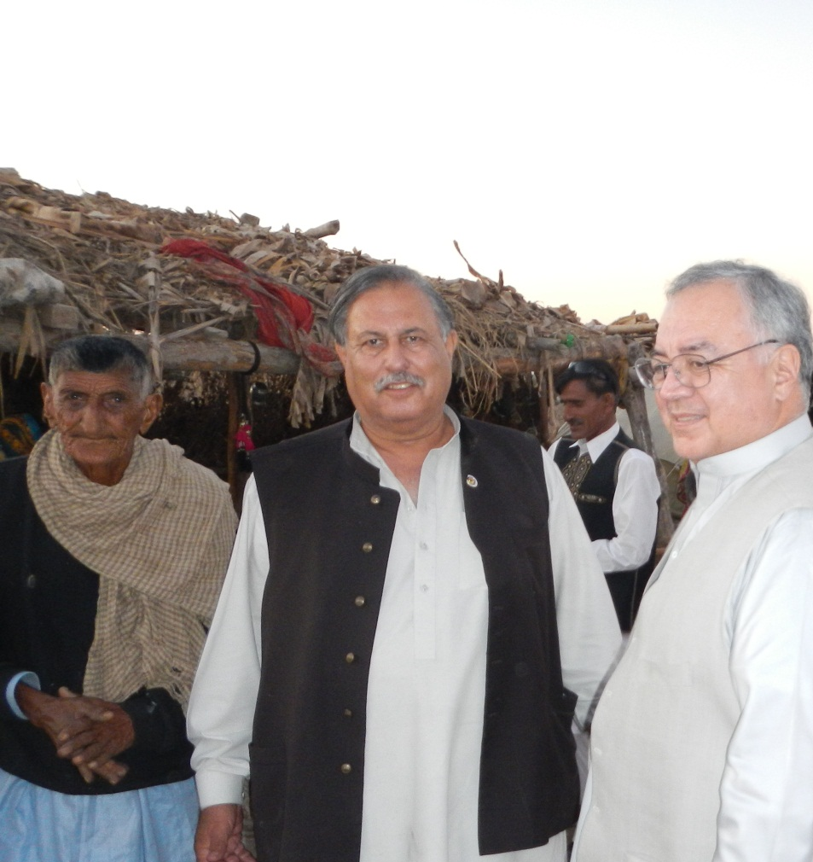
Soft Power Engineering®
– Identify key businessman
Brig (R) Azam Effendi
Chairman Effendi Consolidated Ltd
  Former Pakistan Army Flag Officer
  Heads a Pakistani NGO
  Land owner and farmer
  Well connected business man
  Security Specialist and Analyst
  Family: Afghan ruling class
  Popular with both poor, working class, as well as elite
  Well connected with national government, military, religious, and community leaders
  Has the pulse of the nation
  True humanitarian

Slide 10
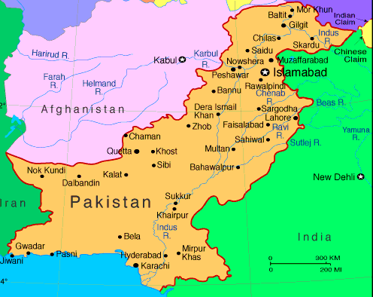
Soft Power Engineering®
- Engagement Strategy
Soft Power Engineering
requires several months of planning
requires application of local wisdom
requires use of religion and culture
is process based
is interactive
is iterative
must focus on winning hearts & minds
must produce outcomes
requires open minds
takes time
takes experience
Day 6-12
Day 2-6
Day 1

Slide 11
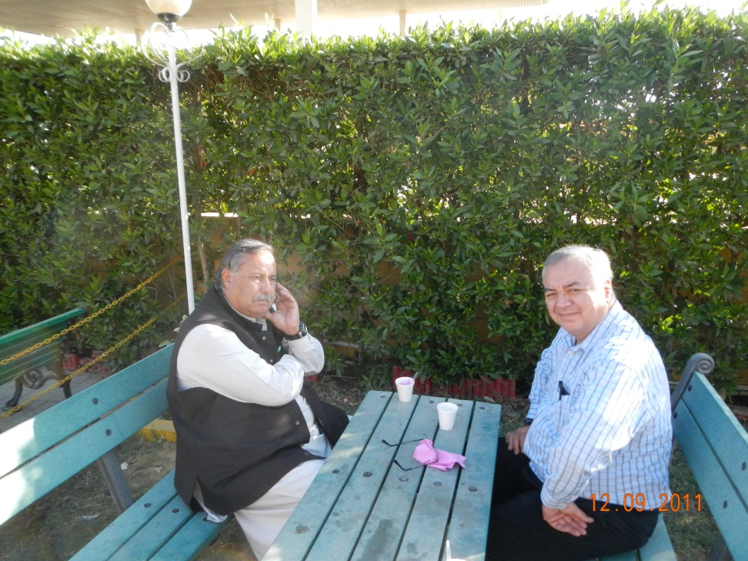
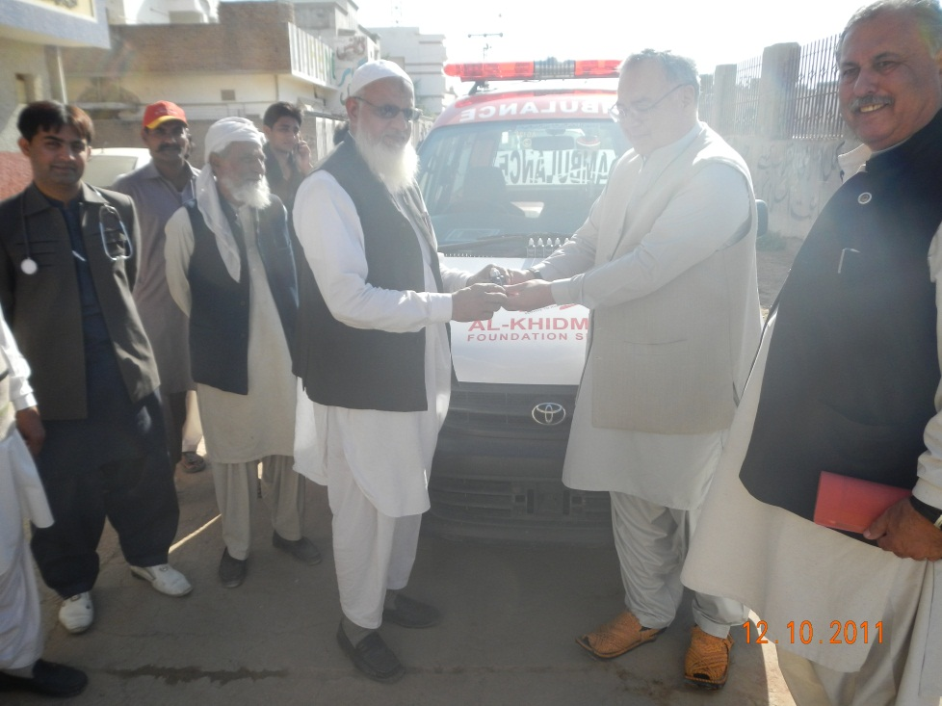
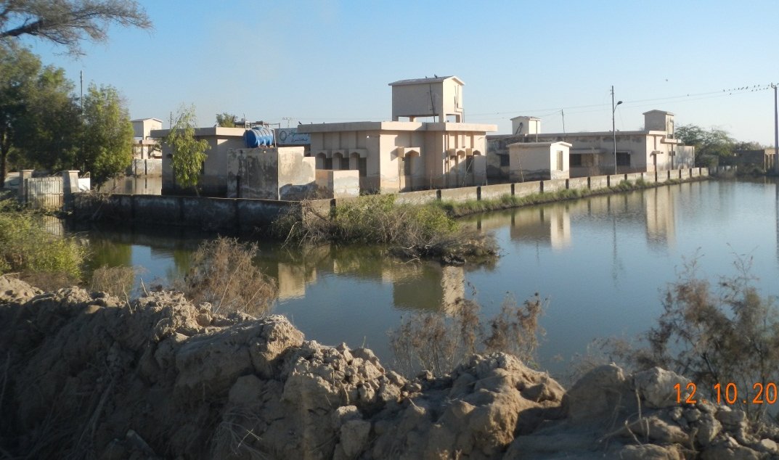
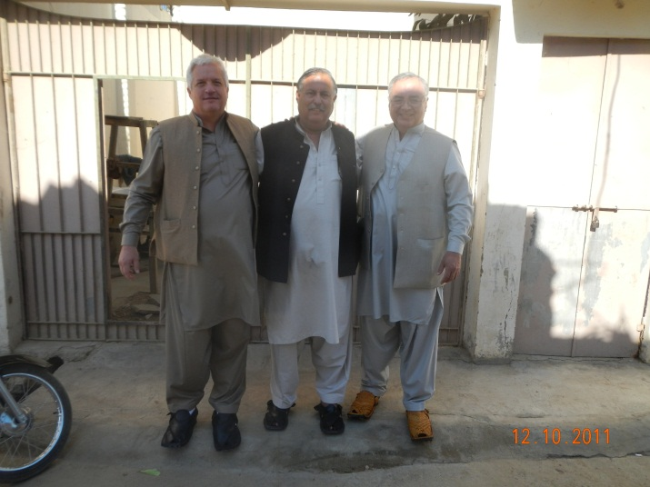
Soft Power Engineering®
- Engagement Strategy – Day 1
Broad overview
Culture immersion

Slide 12
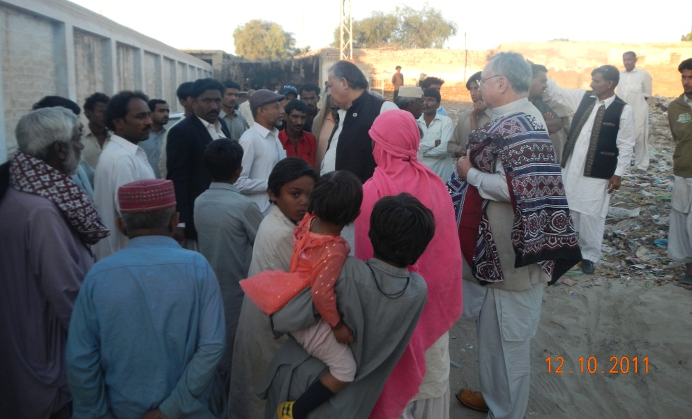
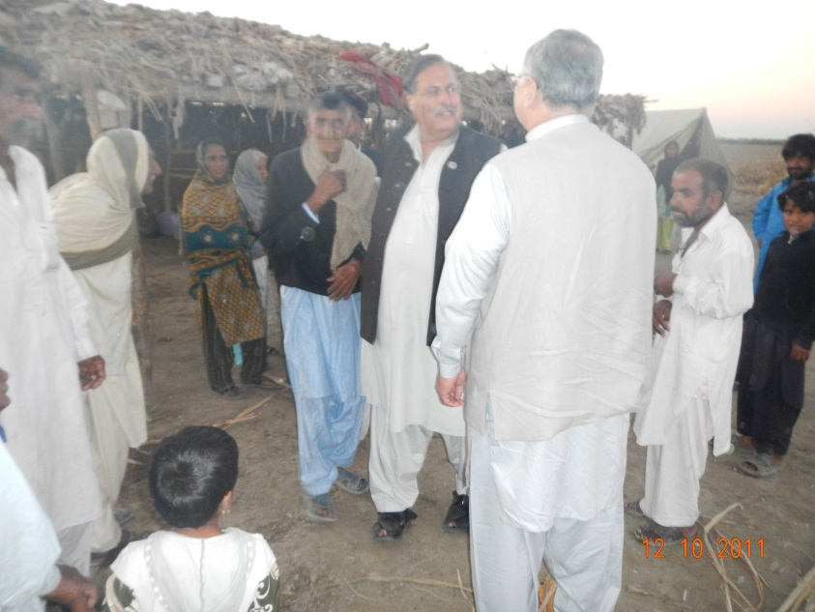
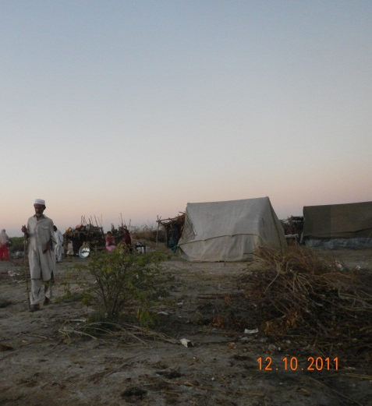
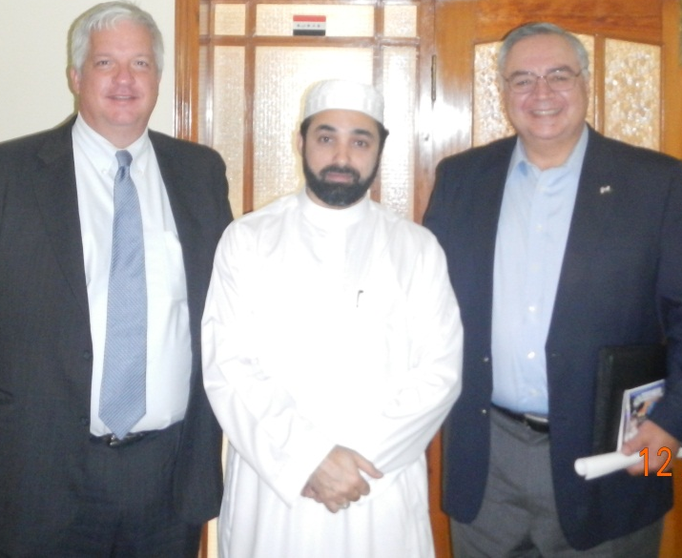
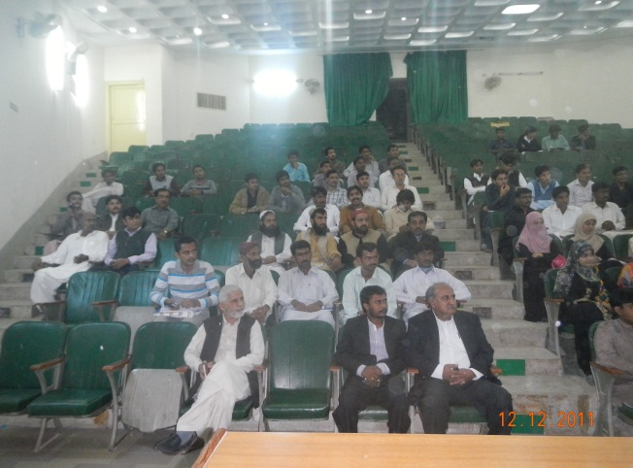
Soft Power Engineering®
- Engagement Strategy – Day 2-5
Working with locals
Understanding their needs
Disaster relief plans
Meeting with the universities, religious leaders and businessmen

Slide 13
Soft Power Engineering®
-Days 2-5
Sindh region – Flooded areas
Hyderabad
  Community & religious centers
  Welfare hospital
  Local chiefs
  Press club interview for local television
Shah Sab
  Major land owner
FM 91 radio interview
Food distribution
  Sindh Agricultural University

Slide 14
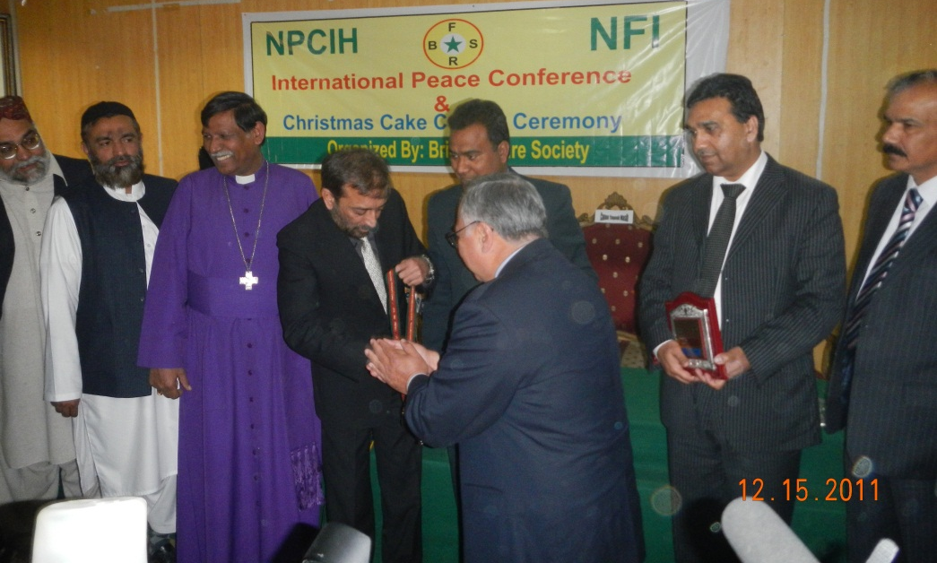
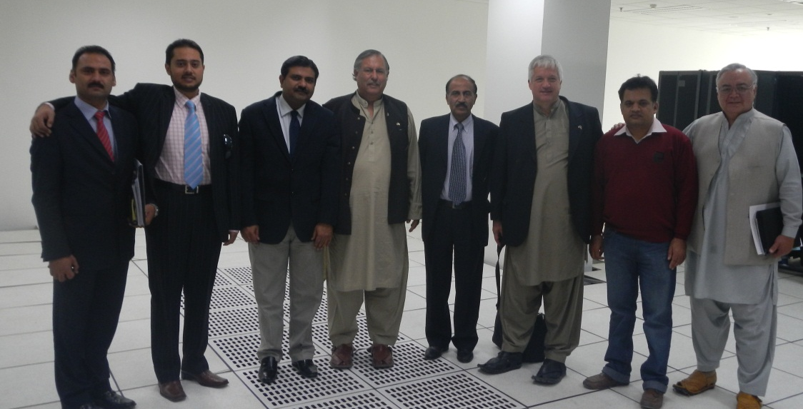
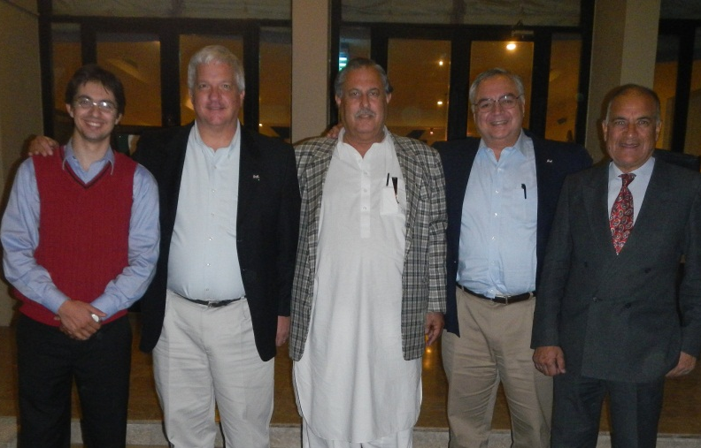
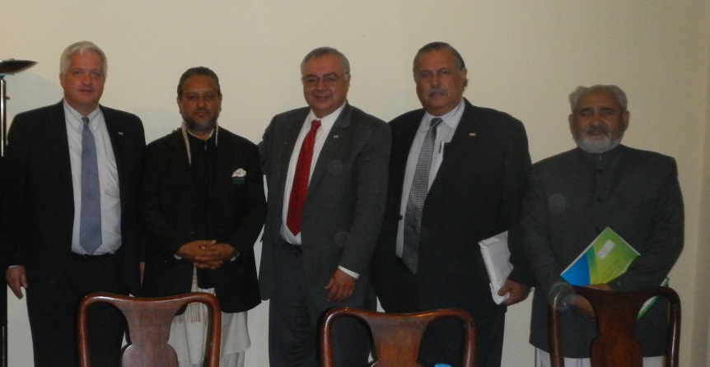
Soft Power Engineering®
- Engagement Strategy – Days 6-12
Meetings with businessmen, government leaders, religious leaders
Second round of concepts presented
MOUs prepared

Slide 15
Soft Power Engineering®
- Days 6-12
Islamabad
  Pakistan National Planning Commission
  Pakistan National Disaster Management Authority
  International Peace conference
  U.S. Embassy (Dept. of Commerce, USAID, Defense Attaché)
  Press Club interview (Televised)
  Pakistan Agricultural Research Council (PARC)
  Religious leaders
  Islamabad Club (secure, informal venue)

Slide 16
Soft Power Engineering®
- Days 6-12
Lahore
  Pakistan Technology Park
  USAID
  Kashmiri leadership
  Punjab University
  Board of Investment and Trade

Slide 17
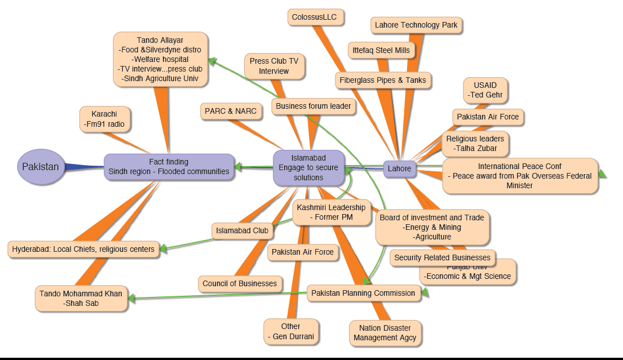
Soft Power Engineering®
- Engagements lead to engagements
Soft Power Engineering® enables the multiplicity of dynamic communication paths

Slide 18
Soft Power Engineering®
-Identified Opportunities Driving PRIME™
Islam web site for better understanding | GIFT for planning commission | Biodiesel feedstock planting
Kashmir web site for better understanding | GIFT for antiterrorism police | Pictometry for planning commission
SilverDYNE for human disaster relief | Nano Technology in agriculture | Pictometry for flood response
GeoCOP for flood response | SilverDYNE for livestock disaster relief | Pictometry for military
Geodetic information Fusion Technology (GIFT) for municipalities | SilverDYNE for poultry | Bank security for internet
GIFT for DRRR | SilverDYNE for vegetables | Pictometry for revenue/tax collection
GIFT for agriculture | Crystal Ball for flood response | Software training for Pakistani military
GIFT for Armed Forces and Security Forces | SilverDYNE for general water purification | Lease-to-own boats with flood relief access
GIFT for US Embassy and consulates in Pakistan | Lease-to-own buffalos | Microsoft Pakistani license negotiation

Slide 19
Soft Power Engineering®
- Example Outcome
Identified needs in the agricultural and economic community
Identified organizations and individuals wanting to be responsible for change
Identified actions to be taken by all parties
On-going work to identify funding, personnel, and activities
  Research on the use of Nano colloidal silver to support
    Clean water
    Uses against infection
    Sanitization of fruits and vegetables
  Educational information exchange needs
  Graduate student education goals for Pakistan to utilize US education
Agreement with PARC
Affects Perception, Education, Medical/Health, and Economics

Slide 20
Pol-Mil Topics and Issues
  Islam and Kashmir
  Pakistan – Afghanistan Strategy
  AF-PAK-US Relations
  November 26, 2012 friendly fire
  Questions from PAK military that affect regional stability

Slide 21
Findings
Soft Power Engineering® resulted in success
  CREW: Effectively defined engagement
  PRIME: Produced situational awareness and positive outcomes
  Family & custom makes Pakistan communities highly productive & powerful influencers
  Won the support of critics and detractors
The Kerry – Lugar Bill (KLB): Pakistan views are mixed
  Sovereignty issues and conditional provisions
  Perception that Pakistani communities are not engaged
  Creating potential rift between Army and CIV government
What Soft Power Engineering® can do
  Create impactful public – private partnerships
  Allow the Pakistan people/communities a voice to be heard
  Increase community support and stability
  Address political and operational engagement challenges
  Affect mutually acceptable modifications to KLB
Notes:
Leverage this experience to identify solutions acceptable to US and Pakistan that can be funded by Kerry-Luger Bill
Identification of programs and projects of interest to both countries and a CREW™ and PRIME™ weighted score
Detailed design of the programs and projects
Continual monitoring of program/project criteria and CREW™ and PRIME™ score (a weighted effectiveness score) and engagement with stakeholders
Modifications of funded programs and projects as agreed to by both projects if necessary
Identify outcome oriented capacities for all State Partnership Programs
Keep the momentum
Engage SPS under an umbrella contract funded by the Kerry-Luger Bill (or other means) to work Pakistan tasks (engages businesses, universities, government, and other key stake-holders)
Use Foreign Military Sales to deliver GIFT for military and HADR use in Pakistan
Engage SPS to make Soft Power Engineering® under the State Partnership Program to build the method for evaluating programs and projects for

Slide 22
Findings – SPS Experience
Cultural immersion & fact finding produced mutual understanding
Trust earned in communities opened access to stakeholder leadership and exclusive venues
  Senior levels of Pakistan government
  National level industry, academia, community, & religious leaders
  Political leaders (Parliament and PM of Independent Kashmir)
  National TV and radio broadcasts
  Unencumbered and open discussion
Gained level of understanding that facilitated engagement outcomes
Notes:
Leverage this experience to identify solutions acceptable to US and Pakistan that can be funded by Kerry-Luger Bill
Identification of programs and projects of interest to both countries and a CREW™ and PRIME™ weighted score
Detailed design of the programs and projects
Continual monitoring of program/project criteria and CREW™ and PRIME™ score (a weighted effectiveness score) and engagement with stakeholders
Modifications of funded programs and projects as agreed to by both projects if necessary
Identify outcome oriented capacities for all State Partnership Programs
Keep the momentum
Engage SPS under an umbrella contract funded by the Kerry-Luger Bill (or other means) to work Pakistan tasks (engages businesses, universities, government, and other key stake-holders)
Use Foreign Military Sales to deliver GIFT for military and HADR use in Pakistan
Engage SPS to make Soft Power Engineering® under the State Partnership Program to build the method for evaluating programs and projects for

Slide 23
The Way Ahead
Soft Power Engineering®
Keep the momentum: Continue with Soft Power Engineering®
  PRIME: Situational awareness and positive outcomes
  Public-private partnerships
  “Win over” critics and detractors
  Provide measures for strategy and monitoring reports
Promote intent of the Kerry – Lugar Bill (KLB)
  Strengthen the long-term people-to-people relationship by investing directly in the needs of the Pakistani people
  Forge a closer collaborative relationship between USA and Pakistan
Leverage this experience to advance KLB provisions
  Economic assistance
  Security Assistance
  Accounting and monitoring
Engage SPS under contract
  Employ Soft Power Engineering® as a collaborative strategy
Notes:
Leverage this experience to identify solutions acceptable to US and Pakistan that can be funded by Kerry-Luger Bill
Identification of programs and projects of interest to both countries and a CREW™ and PRIME™ weighted score
Detailed design of the programs and projects
Continual monitoring of program/project criteria and CREW™ and PRIME™ score (a weighted effectiveness score) and engagement with stakeholders
Modifications of funded programs and projects as agreed to by both projects if necessary
Identify outcome oriented capacities for all State Partnership Programs
Keep the momentum
Engage SPS under an umbrella contract funded by the Kerry-Luger Bill (or other means) to work Pakistan tasks (engages businesses, universities, government, and other key stake-holders)
Use Foreign Military Sales to deliver GIFT for military and HADR use in Pakistan
Engage SPS to make Soft Power Engineering® under the State Partnership Program to build the method for evaluating programs and projects for

Slide 24
Back Up Slides
Pol-Mil Topics and Issues
Summary of Outcomes
Contacts Made (People and Places)

Slide 25
Pol-Mil Topics and Issues

Slide 26
Pol-Mil Topics and Issues
Islam and Kashmir Discussions
Islamabad-Lahore-Karachi (Discussion on Islam). Interacted liberally engaging with religious leaders, preachers, sufis to develop better understanding of Islam and interfaith manifestations related to the present situation. Taliban model of Islam and its cross border affects on AF-PAK affairs present and future Pak-US engagement as related to religion (Islam) and the region.
Lahore (Visit Pak-India Border). Visited Wagah Border to feel the sentiment of the civil society between Pakistan-India and Kashmir issues. Discussed the affects in relation to US and Afghan policy for the future.

Slide 27
Pol-Mil Topics and Issues
Pakistan Afghanistan Strategy
  Taliban is neither friend or foe – they are a reality
  Do not engage sectors of Afghan society, engage the issues
  Address issues that win the hearts and minds (affecting PRIME™)
  Do not disrupt livelihood
  Focus on collaborative and cooperative capacity building
    Aid agencies come & go – trust issues tend to develop

Slide 28
Pol-Mil Topics and Issues
AF-PAK-US Relations – BG(ret) Effendi
AF-Pak relations - Discussed AF-Pak current relations vis-a-vis cross border tensions, future role of US in Afghanistan.
Pakistan role in the future peace process and analysis of the US exist strategy and logistics vis-a-vis Pakistan.
US options to win hearts and minds and Pakistan's actions to regain US trust.
Effect of Drone operations
Counter terrorism effects and negative media role in creating hardships between the people and government of US-Pakistan and Afghanistan- Pakistan and India.
Love of the ordinary Pakistani's, retired servicemen, and professor's of universities for US help in the last 60 years to Pakistan.

Slide 29
Pol-Mil Topics and Issues
November 26 Friendly Fire – BG(ret) Effendi
  Pakistan saw no benefit from participation in investigation
  Soldiers believed that they were under attack
  Some believe NATO attack was deliberate
    Revenge for attack on US embassy
    Fueled trust deficit
  ISI strengthening its position
  Direct confrontation will not diffuse
  Seen and discussed in pol-mil circles as a failure in US policy due to poor execution

Slide 30
Pol-Mil Topics and Issues
From Pakistan Military Leaders
Pakistan: What does the US need from Pakistan?
What does the US want the people of Pakistan to influence?
What counties can Pakistan influence and how can that be done wrt to mutual interests?
Is the US going to stay until 2014? If so, strengthened relationships, logistical burdens, and alignment of interests are a must
Pakistan perceives that both the US & Pakistan are in a corner.
Military leadership of Pakistan is discredited & embarrassed
Current HADR situation...Massive flooding. Need help now with agriculture and water. E.g., specific request for SilverDYNE to USAID denied because of US lack of information.
Notes:
- Pakistan wants to know what the US needs from Pakistan. Requests and focus are contradictory. They are in sensitive times, better communication and collaboration is needed.
- What does the US want the people of Pakistan to influence?
-- I sense that by "people" he means industry, communities, NGO sectors, academia, etc.
- What counties can Pakistan influence and how can that be done wrt to mutual interests?
- Is the US going to stay until 2014? Will it leave abruptly? If staying, solutions wrt strengthened relationships, logistical burdens, and alignment of interests and actionable are a must.
Pakistan perceives that both the US AND Pakistan are in a corner. To get out of that corner must find mutual interests that will better or influence surrounding communities/region/partner nations to showcase success in vested relationship and building capacity strategies.
The military leadership of Pakistan is discredited and embarrassed.
They need to be seen as a partner. Need to focus on building relationships, mutual understanding of gray areas, shift in strategic action.
Current HADR situation. Massive flooding. Need help now. The "American" solution is not always the right one. Water is critical, people suffering now. Do not need chlorine "solution," They need community focused solutions. Community uses and supports SilverDyne.
Pakistan considers it the most effective lifesaver. Communities
know how to use it, it requires no additional infrastructure or distribution network, can de delivered immediately. Two drops per liter makes bacteria contaminated water drinkable in 30 minutes.

Slide 31
Summary of Outcomes

Slide 32
Summary of Outcomes
  Identified disaster response needs focused on agriculture and livestock, health and IT
  Developed a roadmap for (DRR) recovery with Pakistan National Disaster Management Agency
  Memorandum of Agreement with Pakistan Agriculture Research Council (PARC) to introduce Geodetic Information Fusion Technology (GIFT)
  Developed roadmap adopted by the PARC to introduce Nano Technology for agriculture, livestock & poultry.
  Proposal to develop and execute Lahore Technology Park Concept of Operations, establish IT University.

Slide 33
Summary of Outcomes
  Conducted two video taped interviews aired on Pakistani television to discuss our assessment of the stricken areas
  Conducted nation-wide radio interview and question/answer session on Pakistan radio related to peace and US – Pakistan relations.
  Conducted high level discussions and demonstration of capabilities that we have access to
    Director of Pakistan’s Planning Commission, Dir NDMA, senior military officials, academia, community leaders
  Guest lecturer at Sindh Agriculture University regarding practicums of community resilience

Slide 34
Summary of Outcomes
  Distributed food and supplies with NGOs to flood affected people.
  Distributed water purification colloidal silver (SilverDYNE) to flood affected human and livestock population Sindh Agricultural University and Pakistan Agricultural Research Council.
  Entering into formal discussion with Punjab University, Sindh Agricultural University, and University of Virginia to validate roadmap execution
  Engaged with Department of Commerce foreign service officers and Minority Business Development Agency to structure business transactions

Slide 35
Summary of Outcomes
  Leading a round table discussion regarding Pakistan engagement with Department of State, Defense, and USAID to discuss success.
  Participated in Peace Conference in Islamabad based on Interfaith harmony, ethnic cooperation and inter provincial/community conflict resolution.
  Held free and frank discussion with Kashmiri leadership to discuss problems and solutions especially related to US efforts and present perceptions.

Slide 36
Summary of Outcomes
  Identified eight (8) firms and Oak Ridge National Labs to deploy needed capacities. Planning in progress
  Jointly publishing findings with both US and Pakistan
  Publishing findings with the National Defense University. Because of our success, NDU requests that we draft an executive memo that they intend to send to National Security Council

Slide 37
Contacts Made

Slide 38
People & Places
Day 1-3 Meetings
  Karachi
  Government of Sindh
  Dr. A.Q. Mughal, Vice Chancellor Sindh Agriculture University
  S– S.S. Farooq Kazi, Director General of Works
  Business and community leaders
Tariq Mahmood, CEO, Business & Engineering Trends (Boats & GRP)
S. Yusuf Imam, Builder, Developer, Planner and Contractor
Mr. Arif Usmani, MD Citibank*
Tando Mohammad Khan
Syed Zulfiqar Ali Shah, Chairman Sindh Hunting Club and Landlord
Religious Leaders
His Holiness Al Syed Al sheikh Hashim-Ud - Din - Al Qadri AL Gaylani AL Bagdadi (Pir Shab)

Slide 39
People & Places
Day 6-8
Lahore
  Lahore IT Park
  -- Dr. Bokhari
  -- Brig Gen Usman Saeed, IT & Mining.
  -- USAID
  Religious Leaders (Tablighi)
  -- Talha Zubair, Director Preacher and American Lycetuff School, Lahore
  Other
  -- Dr. Khalid, Plastic Surgeon
  -- Sqn Ldr (R) Usman, Pakistan Air Force

Slide 40
People & Places
Day 6-8
Lahore
  International Peace Conference, Islamabad
  Punjab University
  --Prof. Dr. M. Ehsan Malik, Dean of Economics & Mgt Science
  Board of Investment and Trade
  -- Dr. Imran Ahmed Hashmi, Agriculture & Livestock
  -- Waqas Bin Najeeb, Energy & Mines
  Fiber Glass Water Pipes and Tanks Factory
  Ittefaq Steel Mills
  --Mohammad Usman Rangooni US Citizen
  --Abdul Qadeer Khawaja, Financial Advisor
  Colossys LLC Empowering business worldwide
  --Dr. Mahmud Bokhari

Slide 41
People & Places
Day 9-12 Meetings
  US Embassy, Islamabad
    Mr. & Mrs. Cameron Munter, Ambassador
    Brian McCleary, Commercial Counselor
    Tariq Sayeed, Commercial Specialist
    Col Scott Hill, Air Attaché
    Lt Col Jean Havens, Assistant Air Attaché
    Andy Sisson, Director USAID Pakistan
    Katharina Zaver, USAID, Pakistan
    Thomas Miller, Public Affairs *
    Aroosha Rana, Press Officer *
    Jimmy Mauldine, Economic Affairs*
  US Consulate General, Lahore
  Ted Gehr, Director USAID Lahore Field Office

Slide 42
People & Places
Day 9-12 Meetings (Cont.)
  Islamabad
  Pakistan Planning Commission
  Lt Gen (R) Shahid Niaz, Implementation & Monitoring
  National Disaster Management Agency (NDMA)
  Zafar Iqbal Qadir, Chairman NDMA
  Anjum Shikoh Qazi, Director General
  Abdullah Butt – Advisor Technology Innovation
  Government of the State of Jammu & Kashmir
  Sardar Attque Ahmed Khan, Prime Minister
  Sardar Usman Ali Khan President All Jammu and Kashmir Muslim Conference

Slide 43
People & Places
Day 9-12 Meetings (Cont.)
Islamabad
Energy
Brig (R) Azam Effendi, Chairman, Green Global Technologies, Pakistan-Afghanistan.
Col (R) Farooq – Promotion of Jatropha cultivation for Bio-diesel production and Poverty Alleviation in AJ&K and arid lands in Pakistan through private-public partnership in collaboration with Green Global Technologies USA.
Water
Brig (R) Azam Effendi: Special Director and Global Advisor for World Health Alliance Intl USA for purifying water especially in Disaster hit areas.

Slide 44
People & Places
Day 9-12 Meetings (Cont.)
  Islamabad
  National Agricultural Research Council
  Dr. Javed Iqbal – Director Incharge MOU
  Pakistan Agricultural Research Council
  Dr. Khalid Naeem, Member Incharge (Animal Sciences)
  Engr. Muhammad Yasin, Principal Science Officer
  Dr. Nadeem Amjad, Plant Sciences
  Dr. M. Ehsan Akhtar, Land Research Institute

Slide 45
People & Places
Day 9-12 Meetings (Cont.)
  Islamabad
  Business relevant to engagement
  Zeeshan Khlid, CEO, United SOL Ltd, Islamabad
  Mr. Moinuddin Khan, CEO Computers & Communication System, Islamabad
  Farid Uddin, Managing Director, Magnetic Technologies
  Muhammad Razzaq Tiwana, Consultant, Magnetic Technologies
  Col Farooq Magnetology, Kashmir Cause Biodiesel

Slide 46
People & Places
Day 9-12 Meetings (Cont.)
Islamabad
Kashmiri Leaders
Sardar Attique Ahmed Khan
President Azad Jammu & Kashmir Muslim Conference, Former Prime Minister Azad Government of State of Jammu & Kashmir
Sardar Usman Ali Khan, Central Coordinator youth wing
Col (R) Farooq former Military Secretary to President’s of AJ&K and Prime Minister of AJ&K.

Slide 47
People and Places
Follow up contacts made
  Islamabad
  Business relevant to engagement
  Shahid Ahmad Khan, Democratic Senatorial Campaign Board of Trustees
  Business, military, and government leadership
  Lt Gen Asad Durrani, Former Director General, ISI
  Air Vice Marshall Sajid Habid, Pakistan Air Force
  Dr. Farooq Satter, Minister for Overseas Pakistan
  Non Government Organizations (NGO)
  Todd Shea, CEO SHINE HUMANITY (US)
  Canon Yaqub Masih, Bright Future Pakistan (UK)
  Samuel Payara, Bright Future Pakistan

